Slide 1
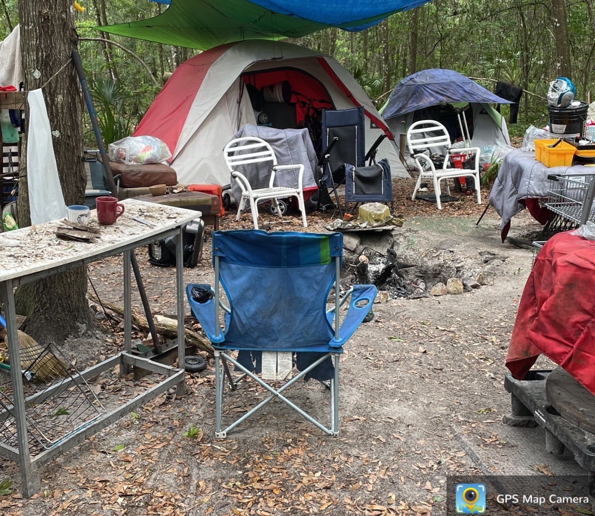
Point in Time Count 2024

Slide 2

The 2024 Point in time count was done on January 23, 2024
The count began on 1/23/2024, however Hud allows counting for the following 7 days

Slide 3
Total Homeless
2024 TOTAL
373788
378
17%

Slide 4
Total Unsheltered Homeless
2024 TOTAL
373788
201
9%

Slide 5
Total sheltered Homeless
2024 TOTAL
373788
177
24%

Slide 6
Total sheltered Homeless
2024 TOTAL
373788
ES 22% TH 28%

Slide 7
Gender

Slide 8
homeless by Age

Slide 9
Race-Sheltered/Unsheltered 2024

Slide 10
HOMELESS Youth sheltered/Unsheltered
2024 TOTAL
373788
UN 30% SH 20%

Slide 11
Veterans

Slide 12
Chronically Homeless 2021-2024
2024 TOTAL
373788
Chronic
14%

Slide 13
Survivors of Domestic Violence-TOTALS 2023-2024
2024 TOTAL
373788
Survivors of DV 60%

Slide 14
Substance use disorder-tOTALS 2023-2024
2024 TOTAL
373788
Substance Use Disorder 23%

Slide 15
Serious Mental Illness-tOTALS 2023-2024
2024 TOTAL
373788
Serious Mental Illness 20%

Slide 16
HIV/AIDS-sheltered and Unsheltered 2023-2024
2024 TOTAL
373788
HIV/AIDS 40%

