Slide 1
PROJECTDOX V9.2 UPGRADE
BENEFITS FOR THE APPLICANTS AND OVERVIEW

Slide 2
Improvements for the Applicants
Additional Information about Version 9.2
Discussion
AGENDA

Slide 3
IMPROVEMENTS FOR THE APPLICANTS
Easier Task Acceptance
Step-by-Step instructions and Learn How videos
Easier file uploading – CORRECTED VERSIONS CAN BE ANY FILE NAME
Easier for applicant to respond to comments
No double “saves”
All review comments in one place
Download link to access markups as downloadable fillable form
Design Professional Sub Applicant Submission
Applicant can add View Only (Design Professionals) during initial upload

Slide 4
EASIER TASK ACCEPTANCE

Slide 5
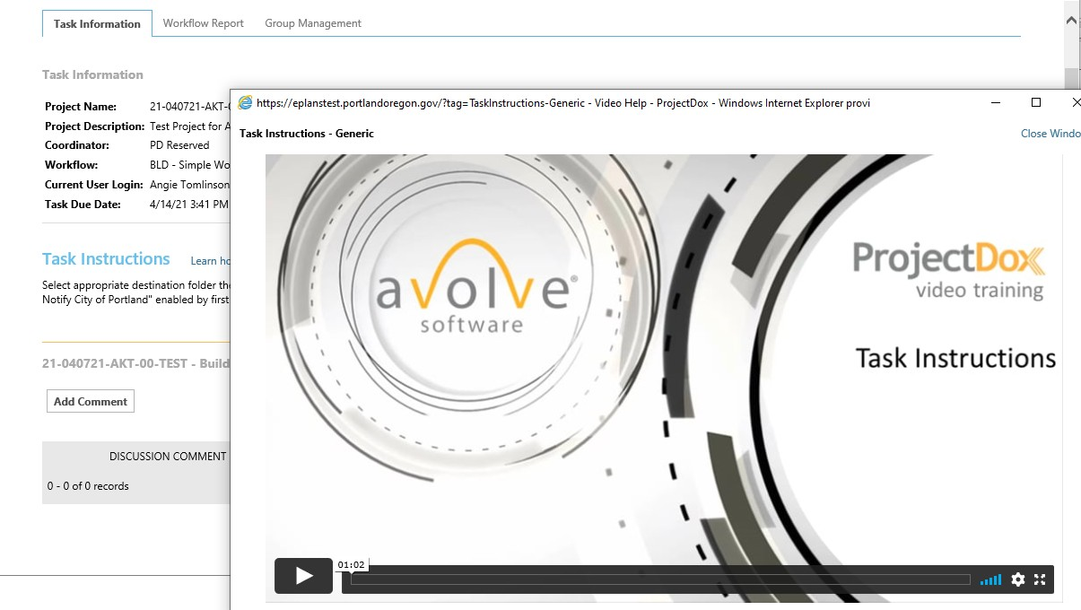
STEP-BY-STEP INSTRUCTIONS AND LEARN HOW VIDEOS

Slide 6
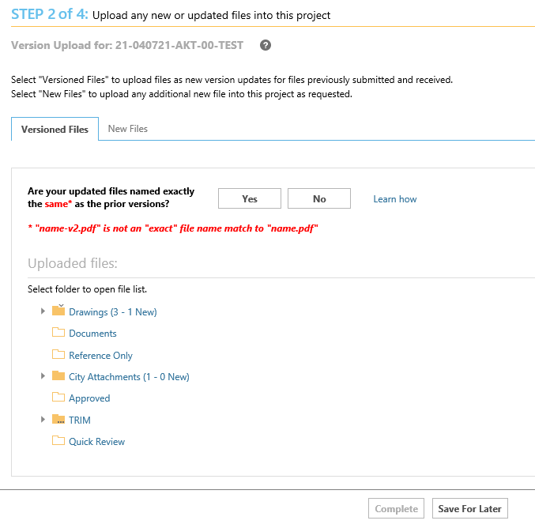
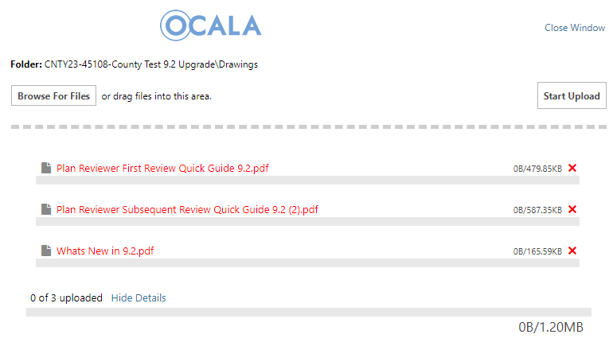
EASIER FILE UPLOADING – CORRECTIONS DON’T NEED EXACT NAMING

Slide 7
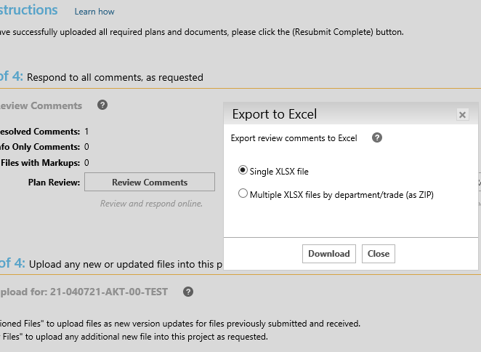
EASIER FOR APPLICANT TO RESPOND TO COMMENTS
No double “saves”
All review comments in one place
Download link to access markups as downloadable fillable form

Slide 8
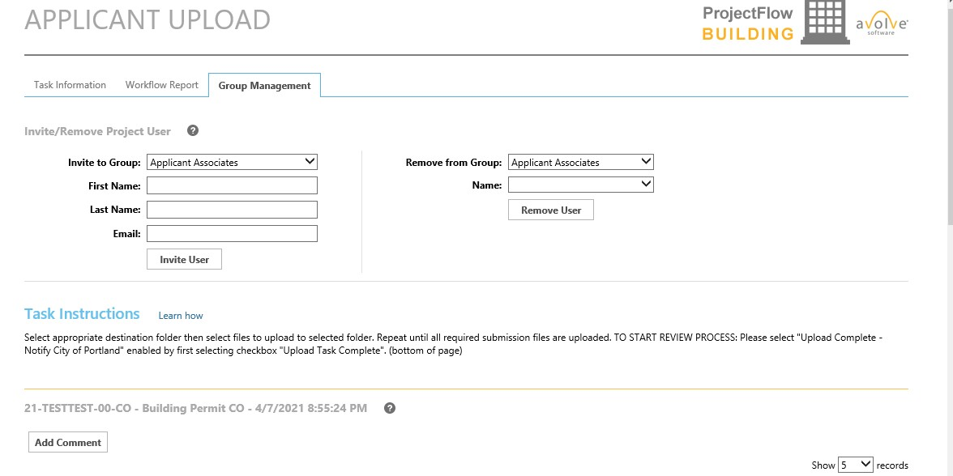
APPLICANT CAN ADD VIEW ONLY (DESIGN PROFESSIONALS) DURING INITIAL UPLOAD

Slide 9
ADDITIONAL INFORMATION
The ePlans team is also running a pilot project with a new Standard Workflow for NSFR (New Single Family Residential) and CO (Commercial New Construction)
ProjectDox 9.2 was designed to enhance the Applicant and Reviewers Experience
ProjectDox 9.2 Upgrade will be live in Ocala 6/8/2023

