Slide 1

City of Ocala Leadership Group Meeting
June 25, 2015

Slide 2
Leadership Group Meeting Agenda
Using Google Groups
Ocala 2035 Vision Review
Accomplishments to Date
Feedback from last meeting
Leadership Goals
New Members
Approval of 3/26 & 5/28 Minutes
Final Comments

Slide 3
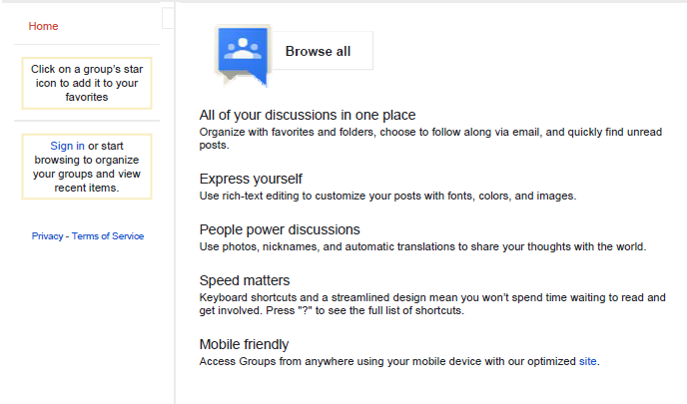
Google Groups

Slide 4
Ocala 2035 Vision Review
Approved in 2010
  Purpose
  Major Issues Identified
  Community Input
Vision Design Topics
  Urban Form & Open Space
  Building & Site Design
  Mobility & Community Connectivity
Strategies
Notes:
Urban form: Where should growth go? What is intensity? Building & Site Design: depending on urban form: placement of buildings and accessories, building design, transparency, façade treatmtents; Mobility & Community Connectivity: connecting n-s / e-w, creating multimodal facilities

Slide 5
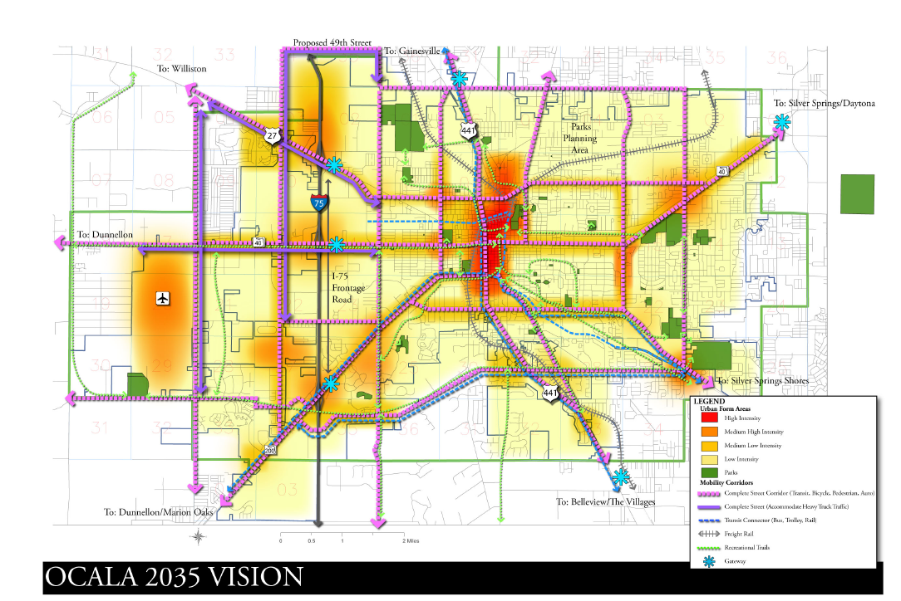
Vision Map

Slide 6
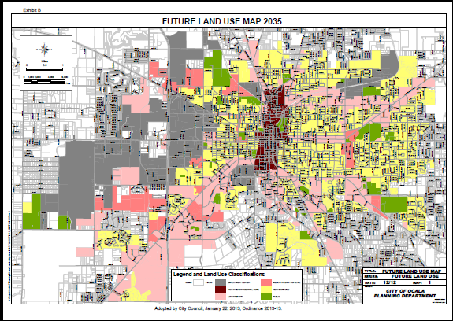
Accomplishments so far…
Comprehensive Plan Amendments
ADOPTED JANUARY 22, 2013

Slide 7
Accomplishments so far… (cont)

Slide 8

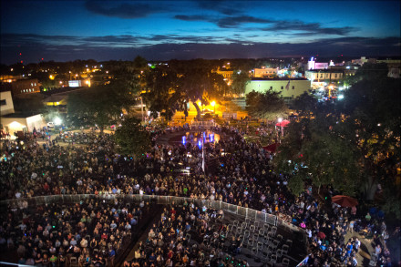
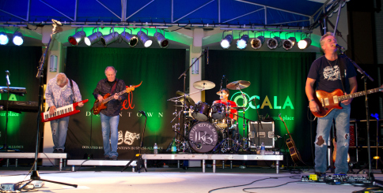
Accomplishments so far… (cont)

Slide 9
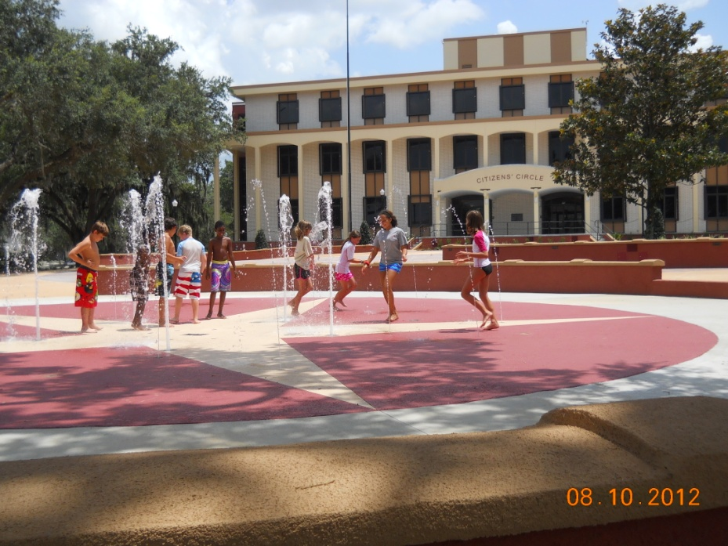
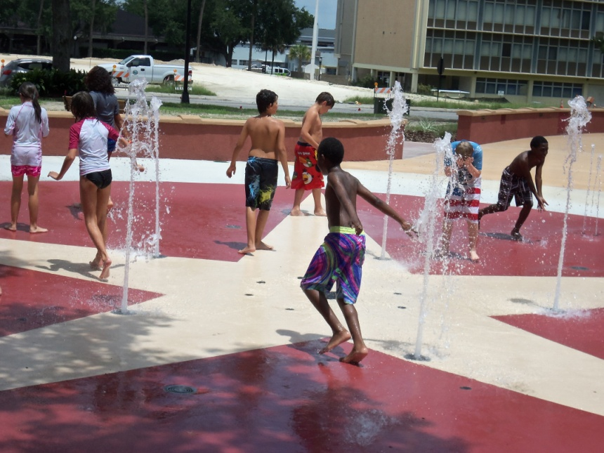
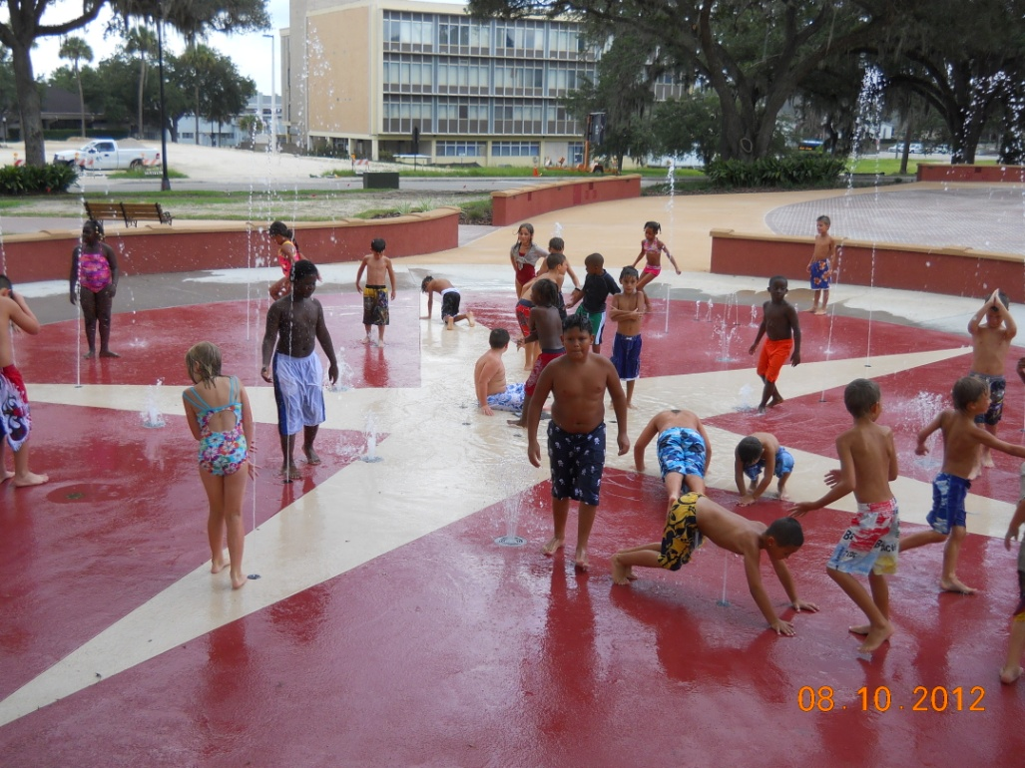
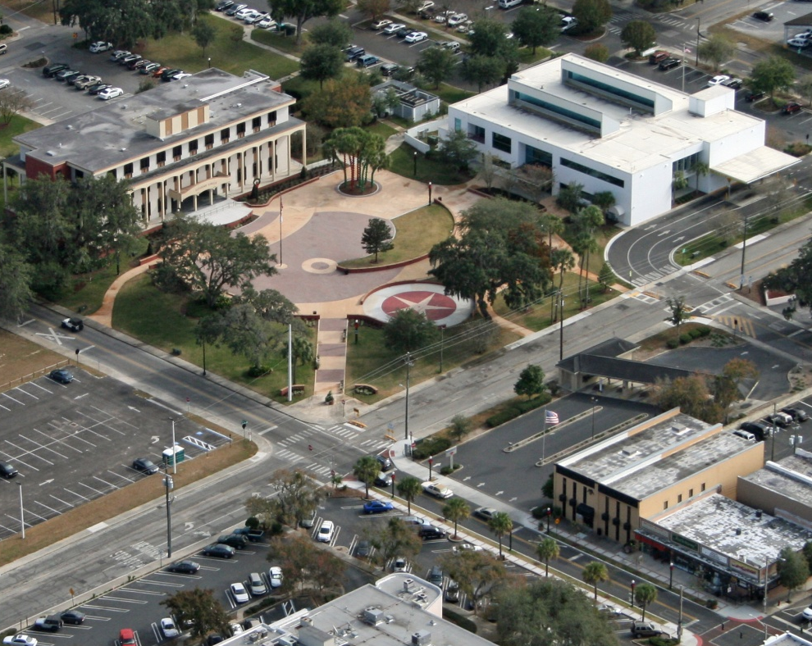
Accomplishments so far… (cont)

Slide 10
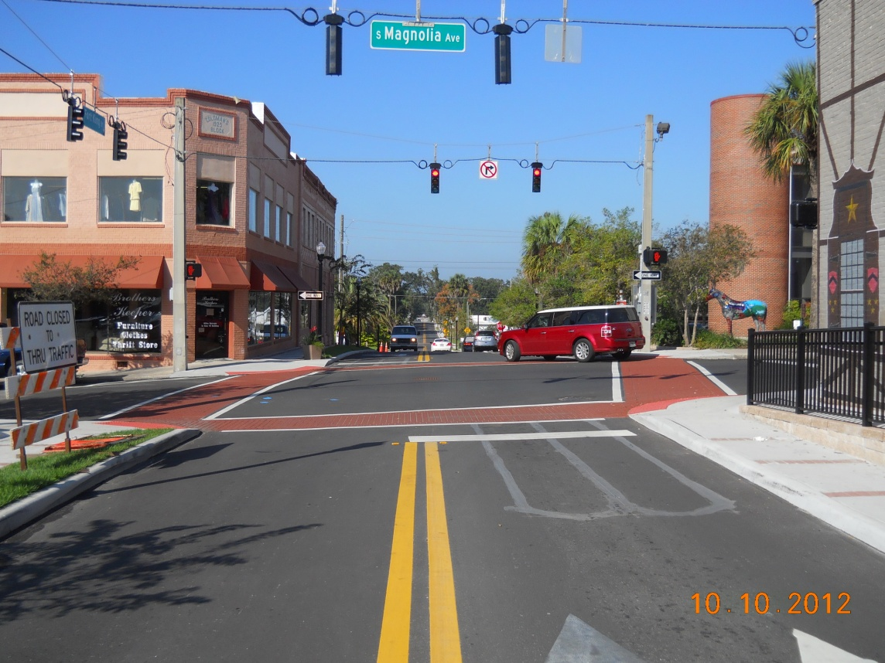
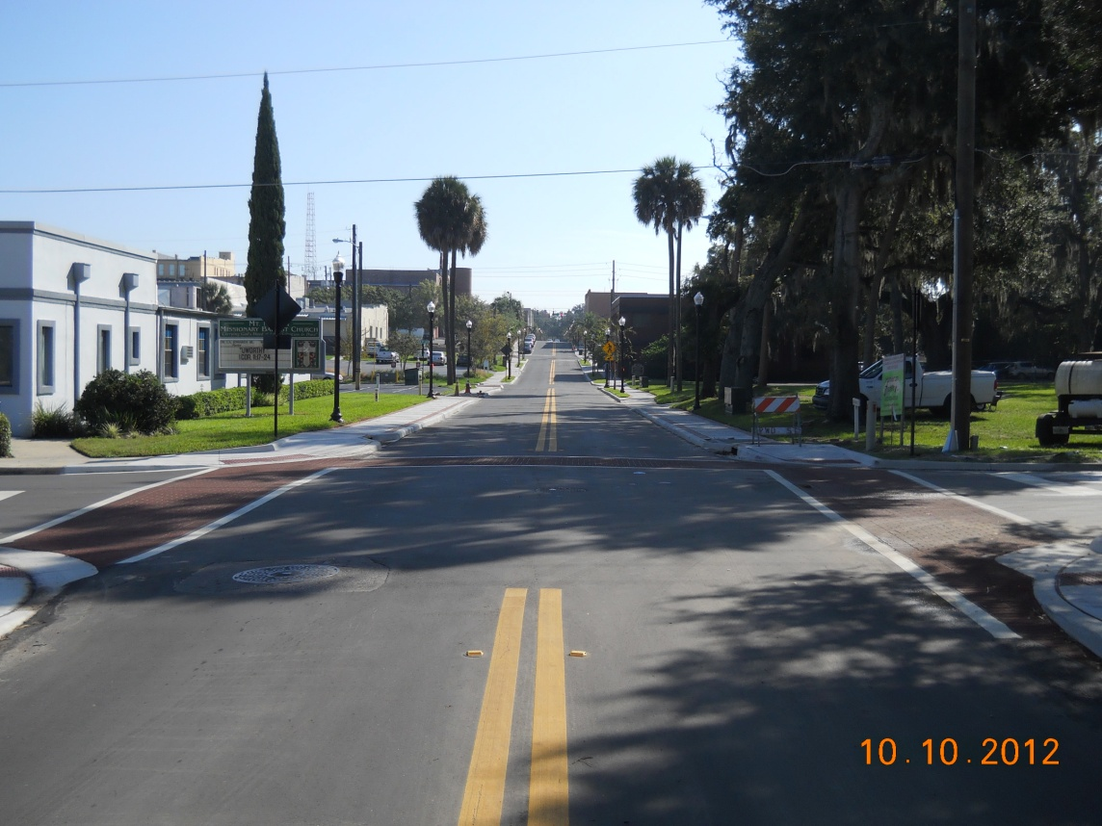
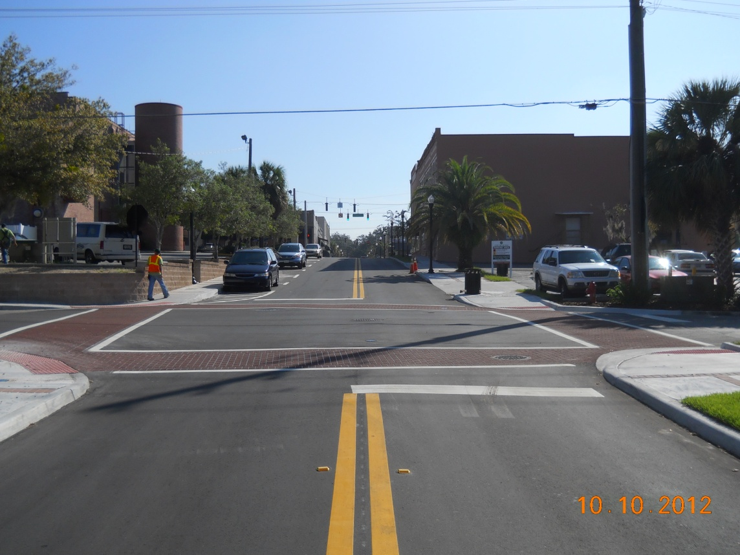
Accomplishments so far… (cont)

Slide 11
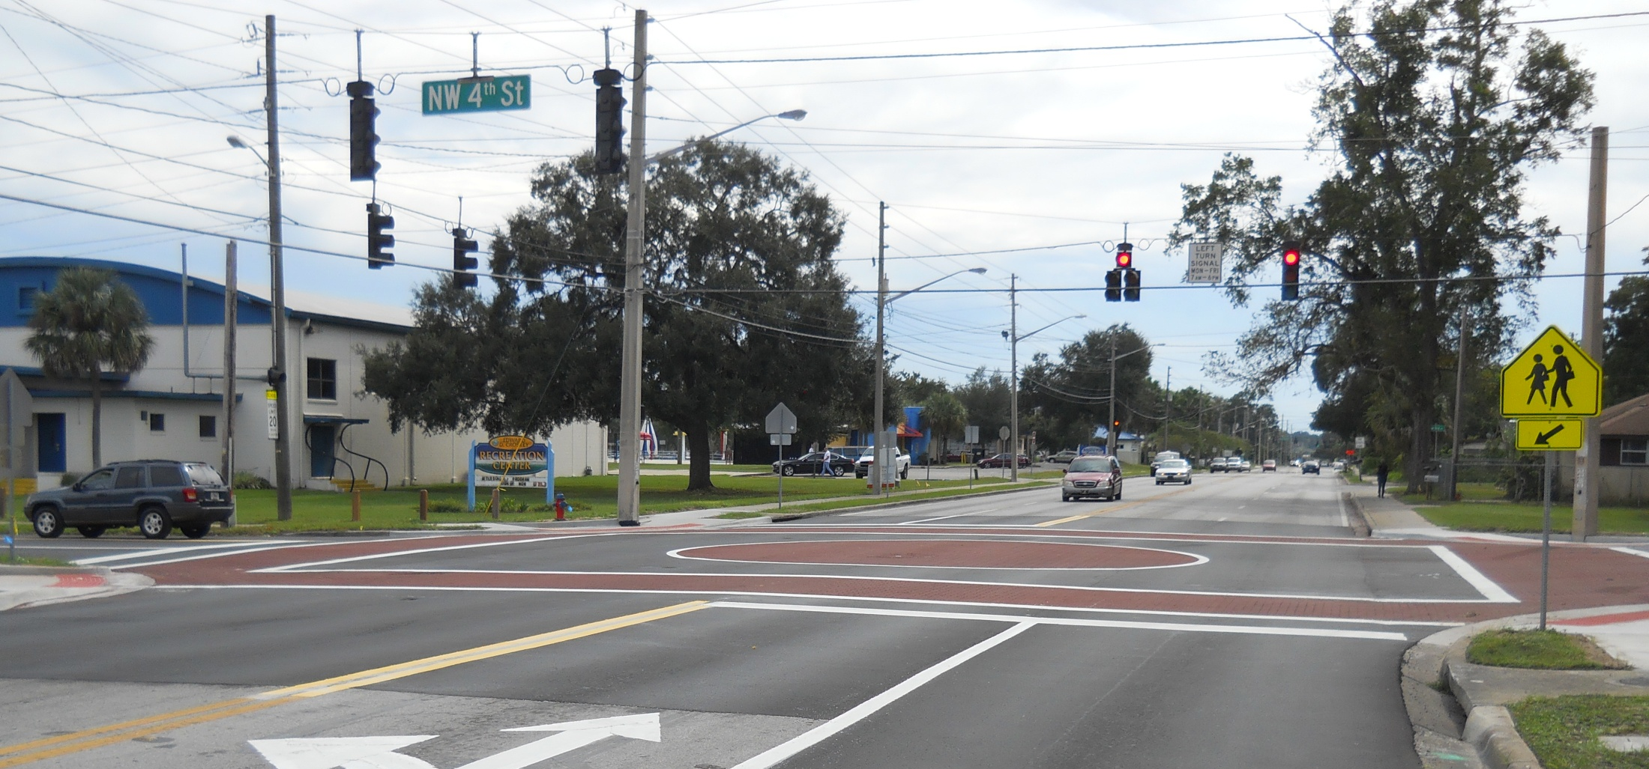
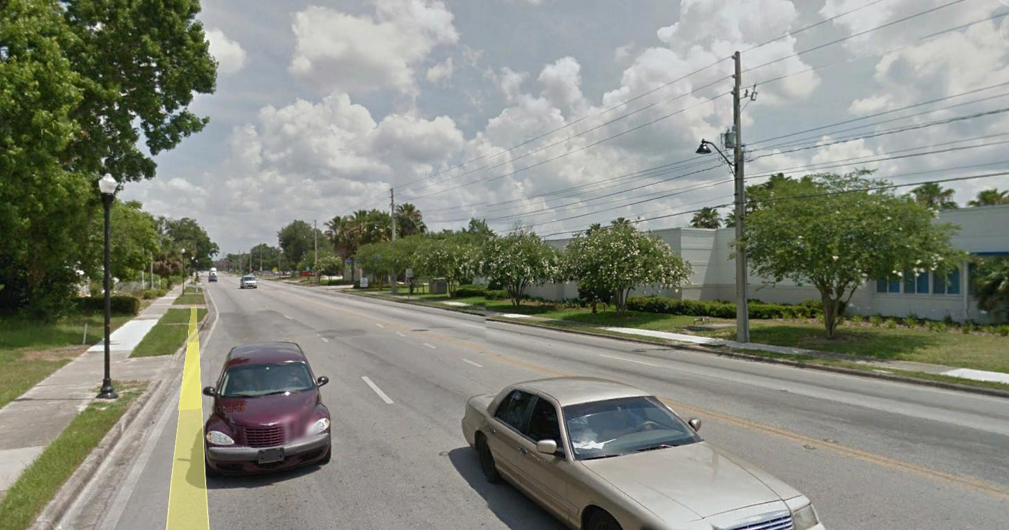
Accomplishments so far… (cont)

Slide 12
Accomplishments so far… (cont)
Other Completed Projects
  Gibbs Downtown Retail Study
  Broadway/Ft King Improvements (Downtown & West Ocala)
  US 441 Feasibility Study
  Wayfinding Plan
  Downtown Retail Attraction, Retention and Expansion Grant Program
  Downtown Upper Floor Mixed Use Improvement Grant Program
  West Ocala Business Revitalization Grant Program

Slide 13
Accomplishments so far… (cont)
Ongoing Projects
MLK/SR 40 Intersection Improvements
Estella Byrd Whitman Wellness Center
Ft King Historic District Improvements
Chamber Lot
Proposed Downtown Parking Garage Project
Property Maintenance Ordinance

Slide 14
Comments from last 5/28 meeting
Communicate more frequently
Provide information regarding projects/proposals early in the process
Follow up with results regarding projects after they are completed.
Provide Vision related information from Council and other Board meetings
Send PPT or presentation material early for review prior to meeting
Notes:
Need to listen to tape or get minutes

Slide 15
Leadership Group Goals

Slide 16

Approval of 3/26 & 5/28 minutes

Slide 17
Upcoming Meetings
City Council Meeting
    July 7 at 4:00 pm at City Council Chambers
    July 21 at 4:00 pm at City Council Chambers
Ocala Historic District Improvement Plan
    July 8 at 4:00 pm at City Council Chambers
    Ocala Historic Preservation Advisory Board
July 9 at 4:00 pm at CSC 2nd Floor Training Room
Planning and Zoning Commission
July 13 at 5:30 pm at City Council Chambers
North Magnolia CRA Meeting
July 16 at 8:30 am at CSC 2nd Floor Training Room

Slide 18
Comments / Questions

