Slide 1
City of Ocala Leadership Group Meeting
December 8, 2016

Slide 2
Leadership Group Meeting Agenda
Proof of publication
Approval of October 27, 2016 minutes
Midtown Master Plan activity (30 min.)
Code amendment for M-1 uses (10 min.)
Code amendment for outdoor storage in B-4 (10 min.)
Paradise Park Plaza (10 min.)
Downtown gas station special exception (10 min.)
Upcoming meetings
Comments / questions

Slide 3
Approval of October 27, 2016 minutes

Slide 4
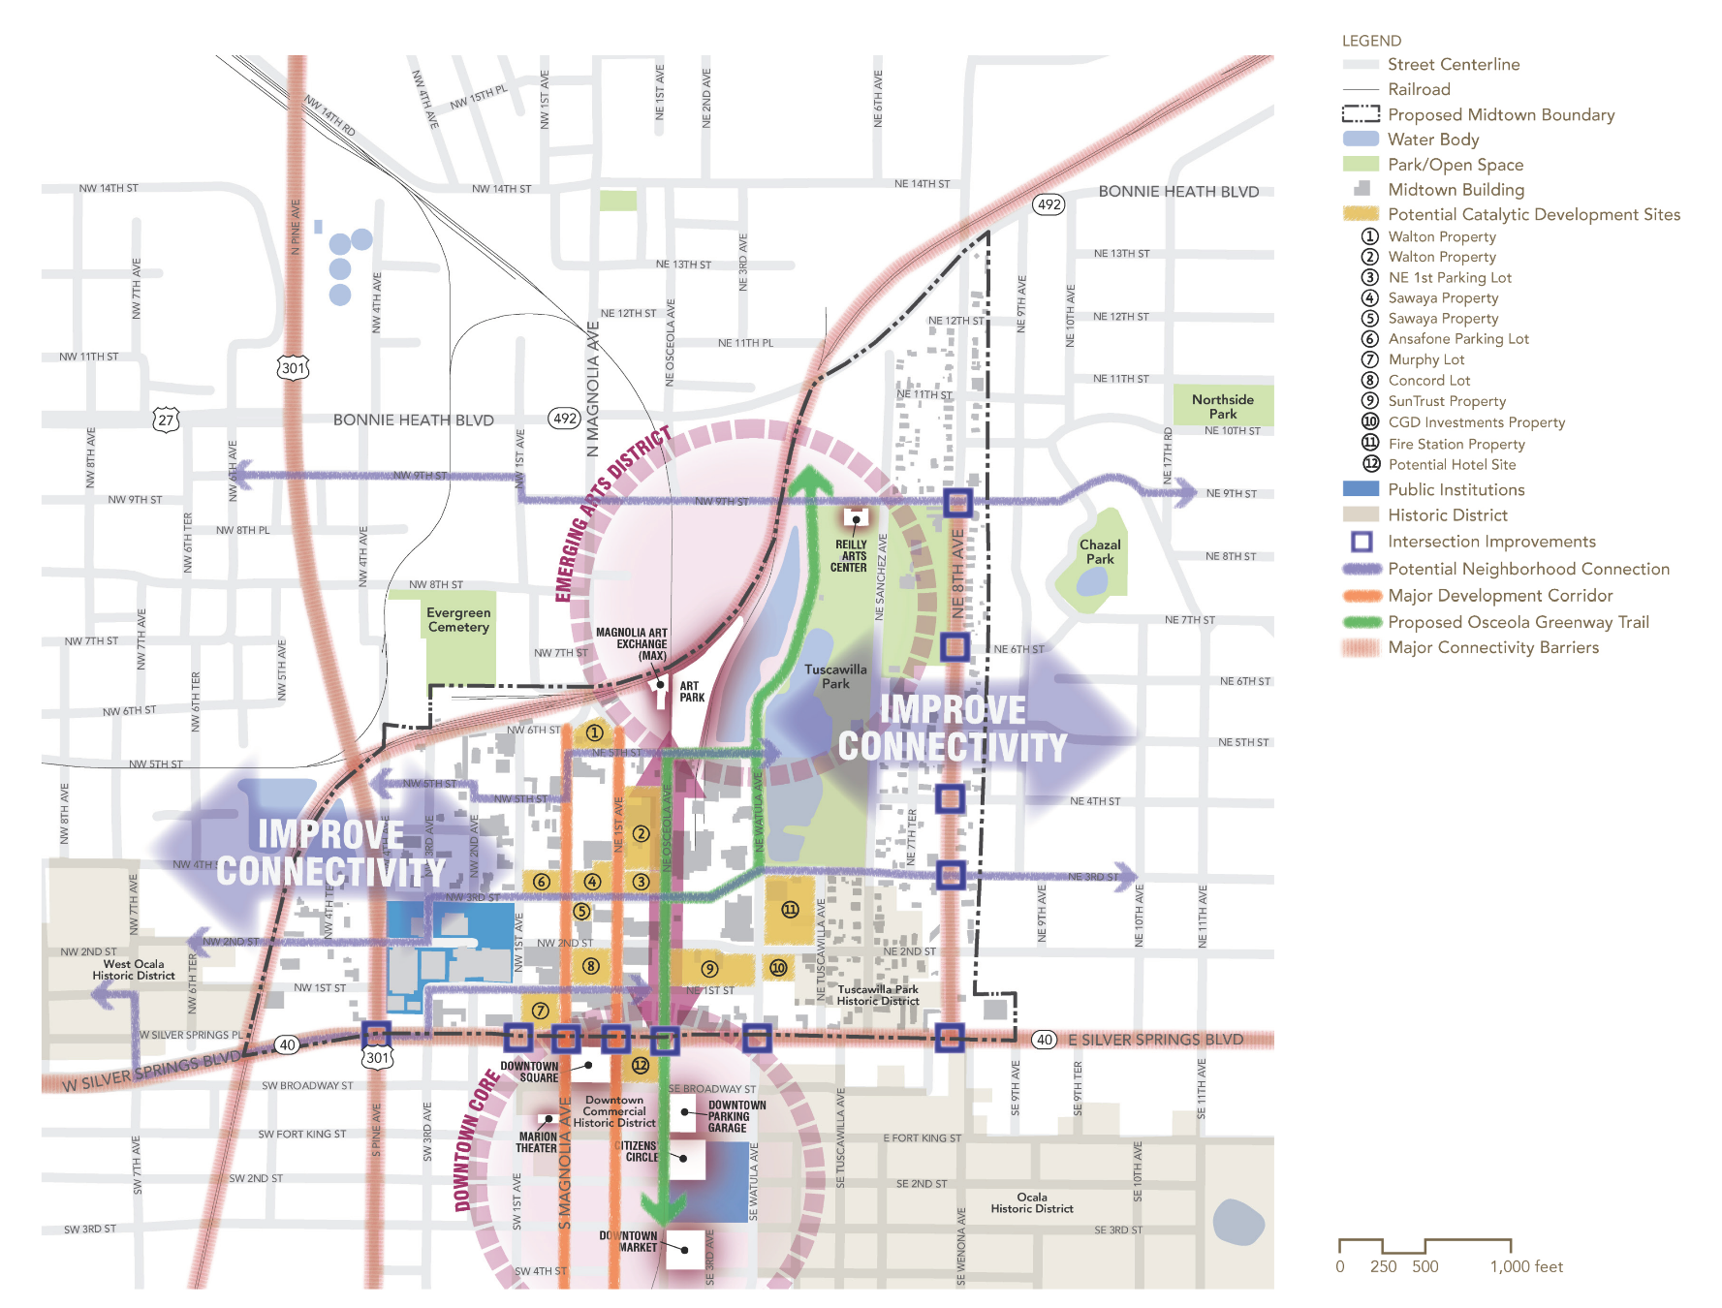
Midtown Master Plan activity

Slide 5
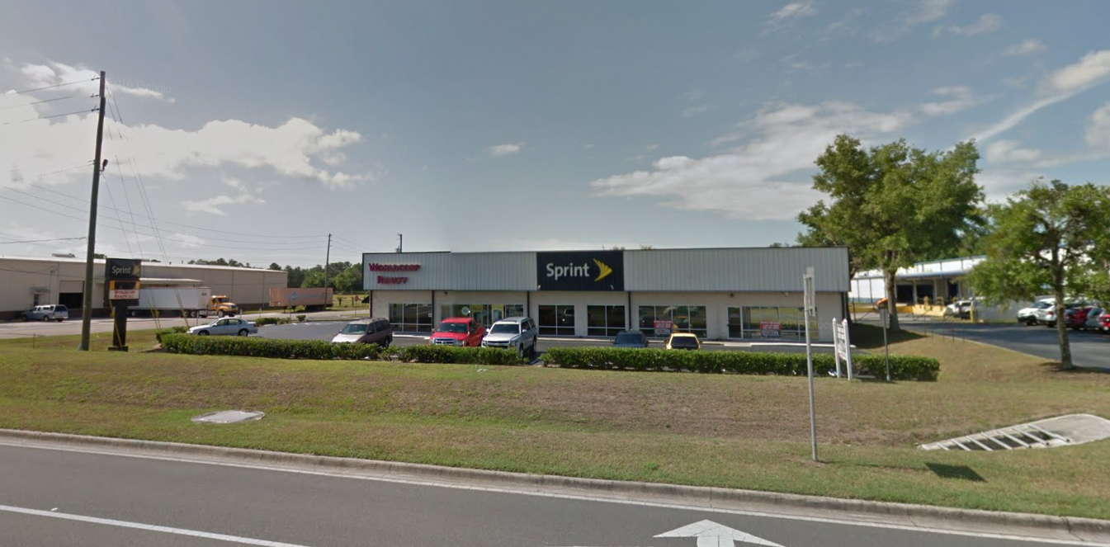
Code amendment for M-1 uses

Slide 6
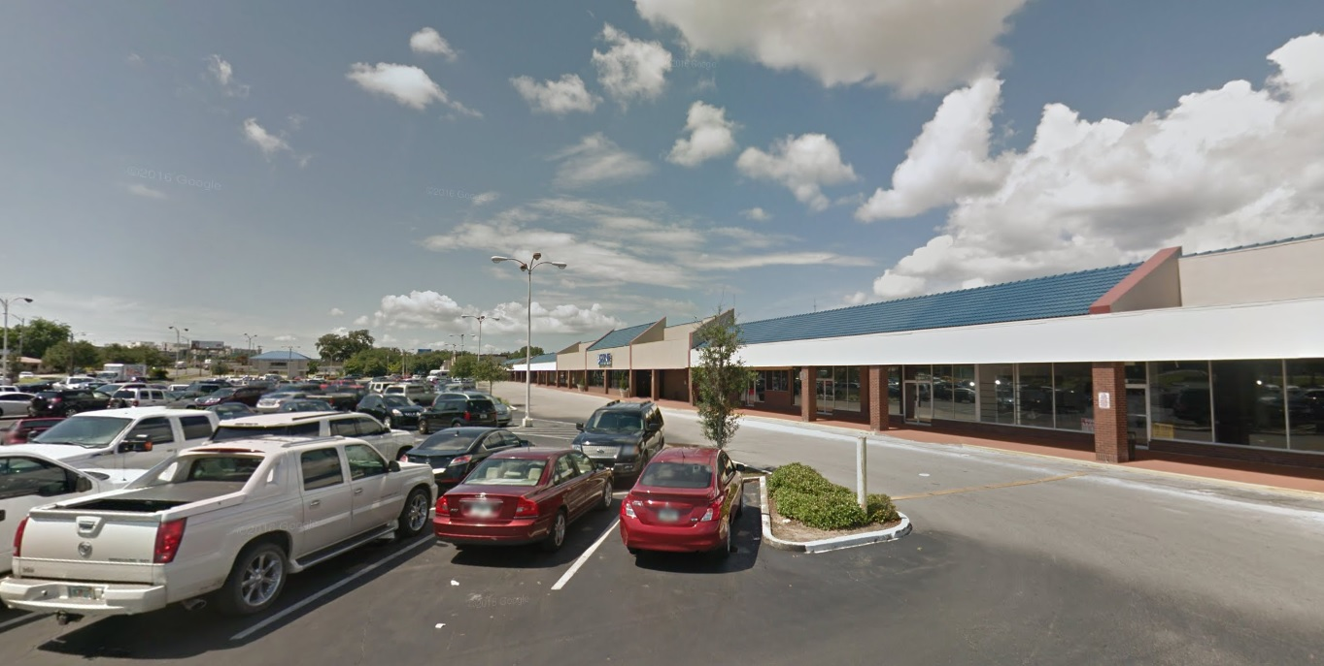
Code amendment for outdoor storage in B-4

Slide 7
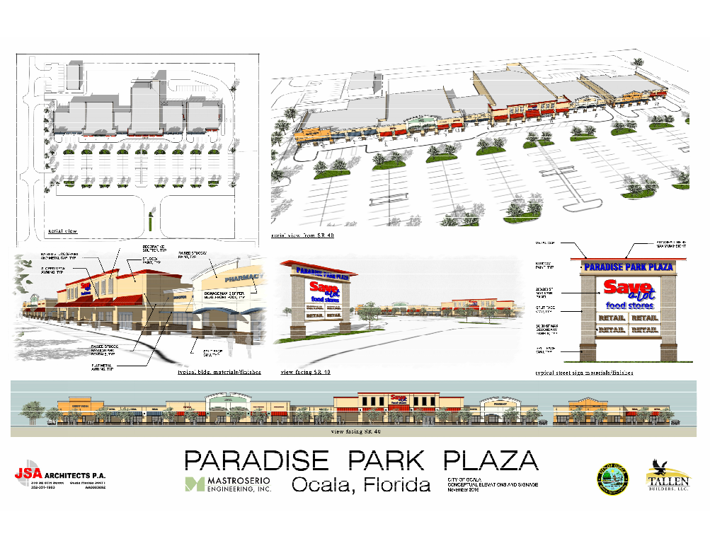
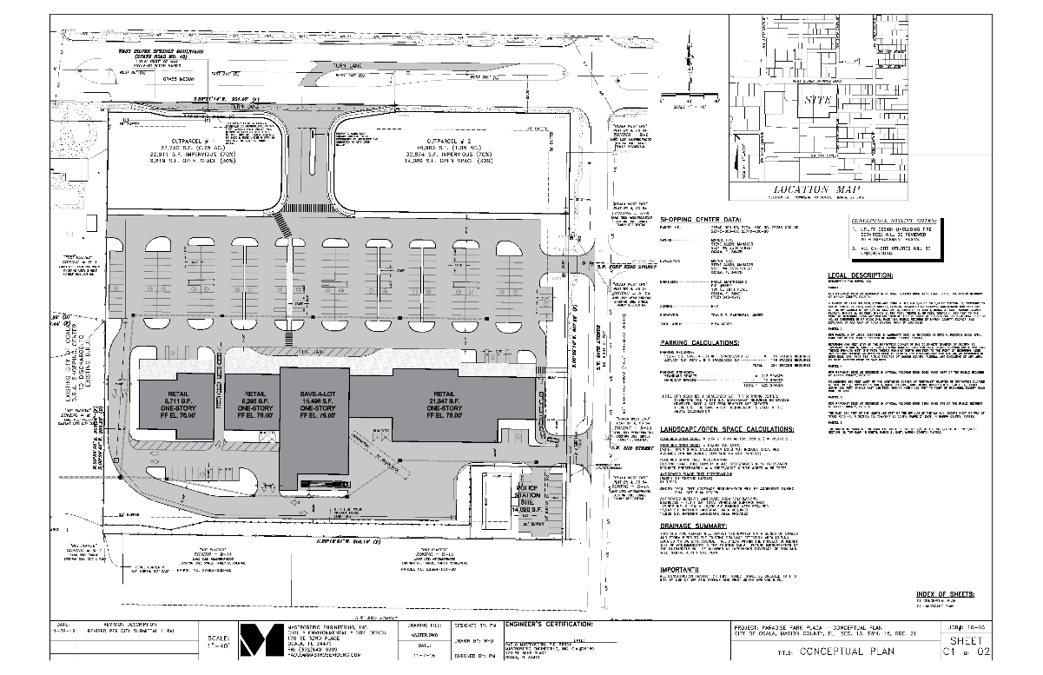
Paradise Park Plaza

Slide 8
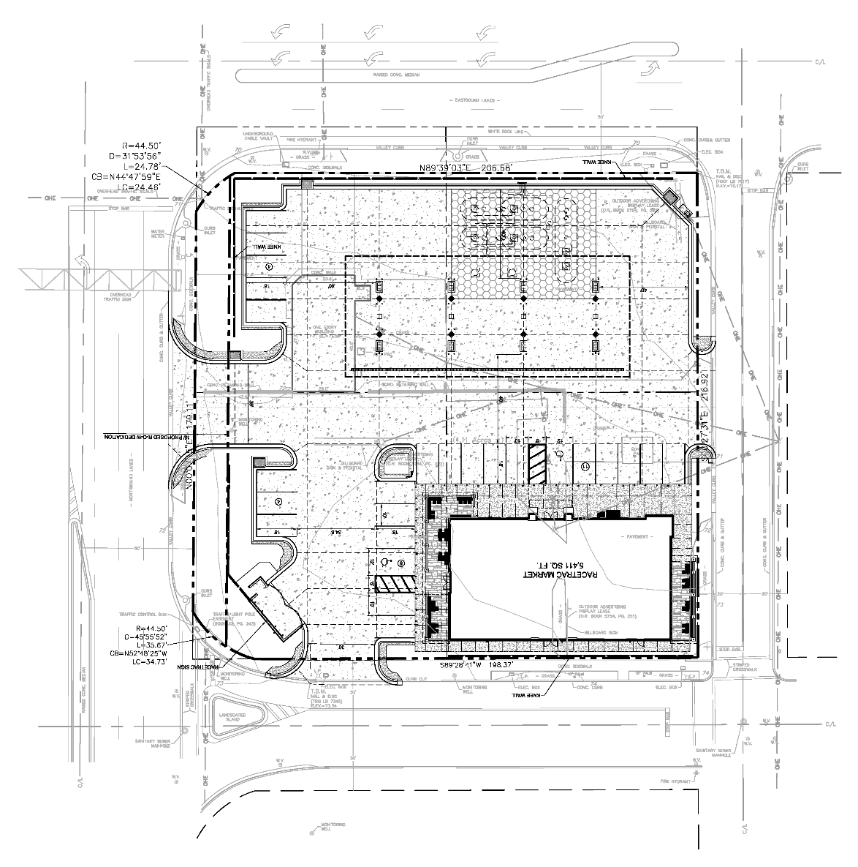

Downtown gas station special exception

Slide 9
Upcoming meetings
Leadership Group
  Thursday, January 26th at 11:30 am at CSC Training Room
City Council
  Tuesday, December 20th at 4:00 pm at City Council Chambers
  Tuesday, January 3rd at 4:00 pm at City Council Chambers
  Tuesday, January 17th at 4:00 pm at City Council Chambers
Ocala Historic Preservation Advisory Board
  Thursday, January 5th at 4:00 pm at City Council Chambers
Planning and Zoning Commission
  Monday, December 12th at 5:30 pm at City Council Chambers
  Monday, January 9th at 5:30 pm at City Council Chambers
Board of Adjustments
  Monday, December 19th at 5:30 pm at City Council Chambers
  Monday, January 16th at 5:30 pm at City Council Chambers

Slide 10
Comments / questions

