Slide 1
City of Ocala Leadership Group Meeting
January 26, 2017

Slide 2
Leadership Group Meeting Agenda
Proof of publication
Approval of December 8, 2016 minutes
Midtown activity recap
Fiscal impact analysis
Code amendments!
DEF blending plant proposal
Upcoming meetings
Comments / questions

Slide 3
Proof of publication

Slide 4
Approval of December 8, 2016 minutes

Slide 5
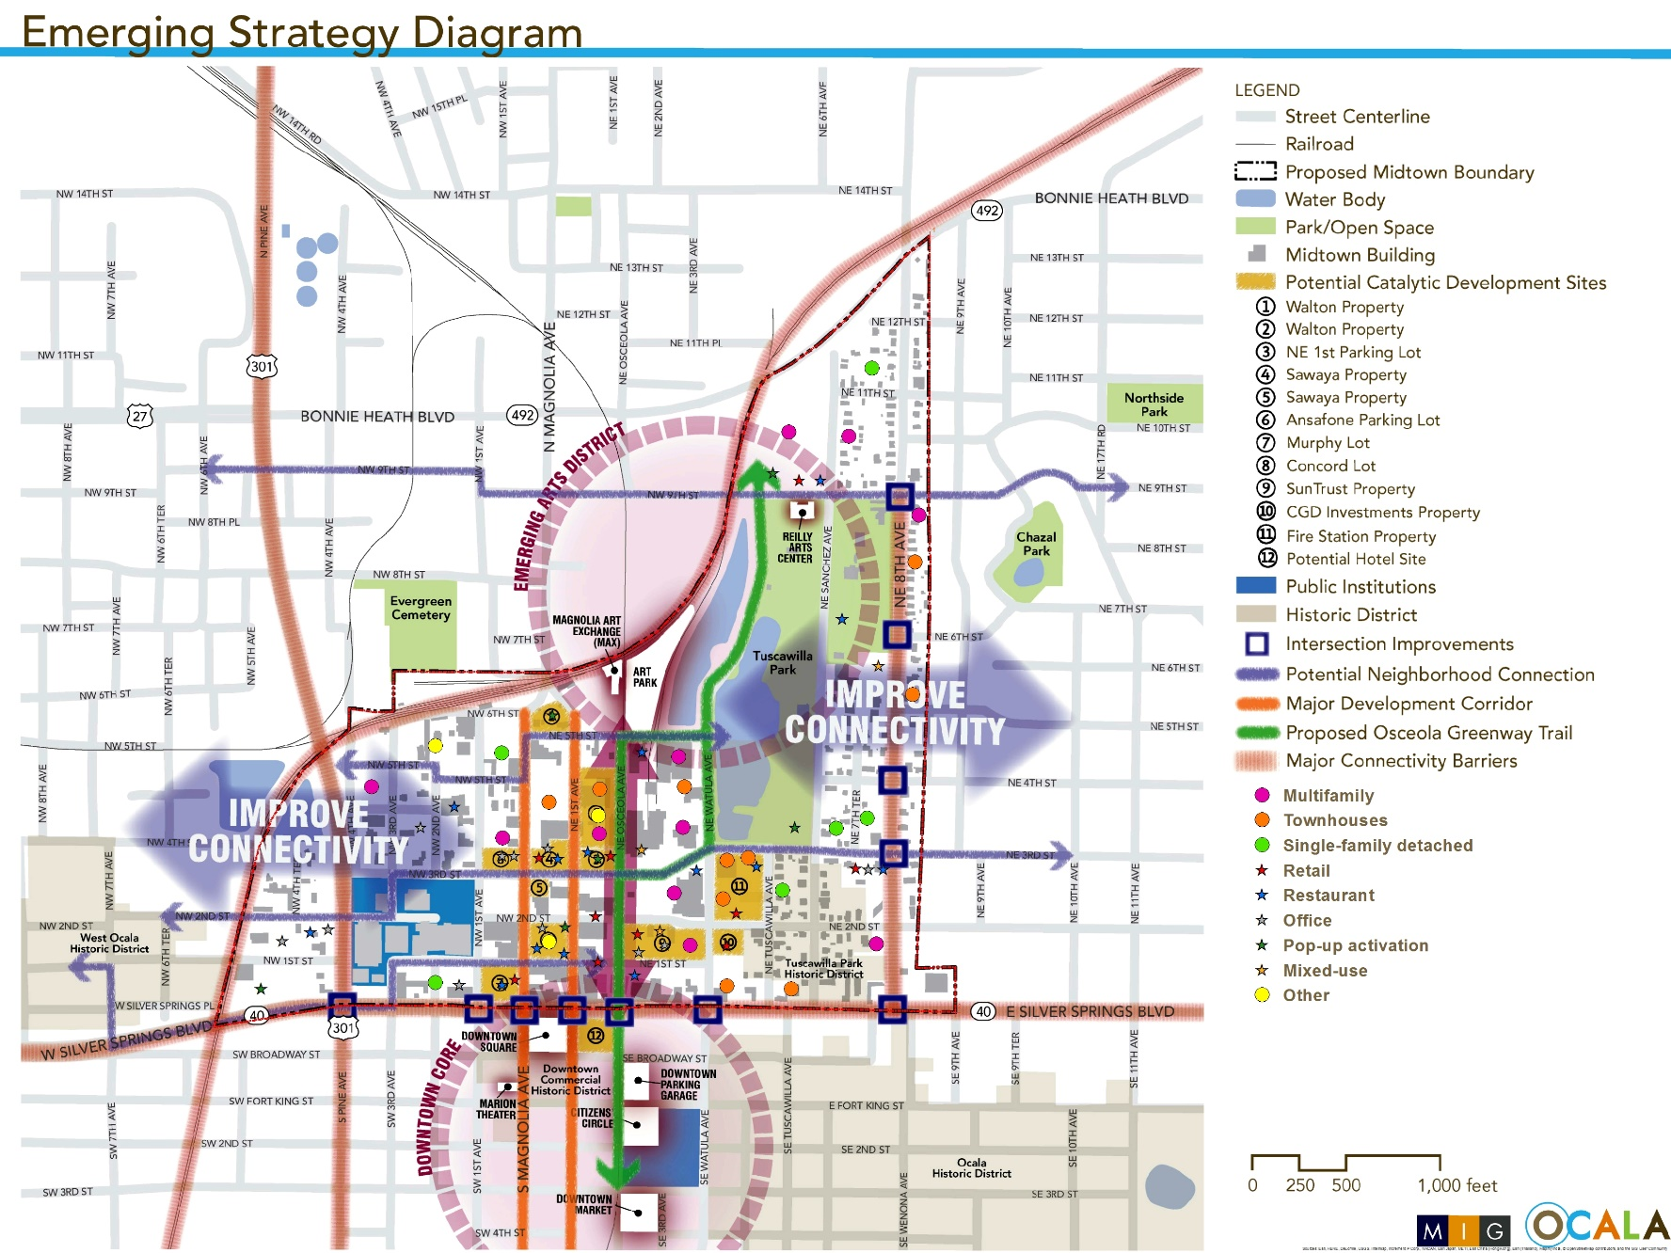
Midtown activity recap

Slide 6

Fiscal impact analysis

Slide 7
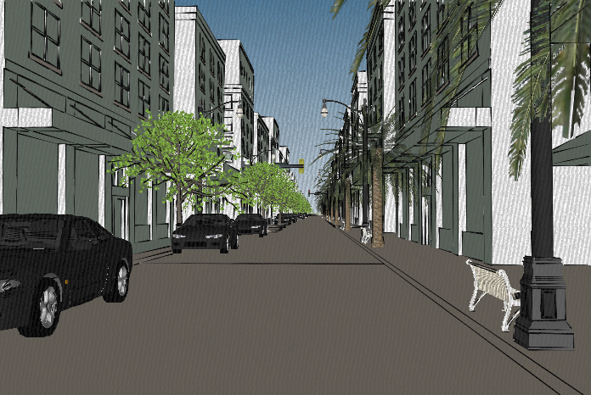
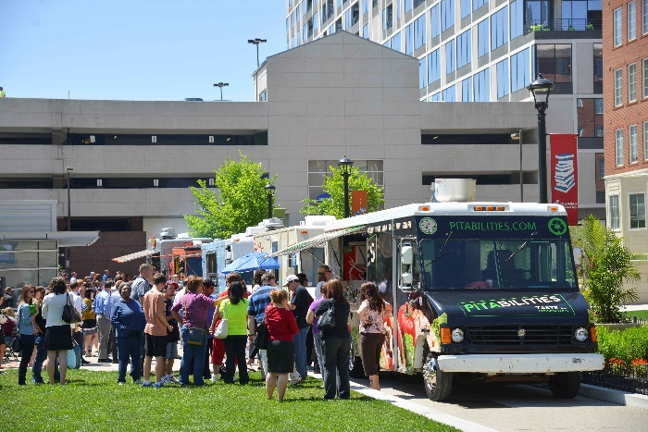

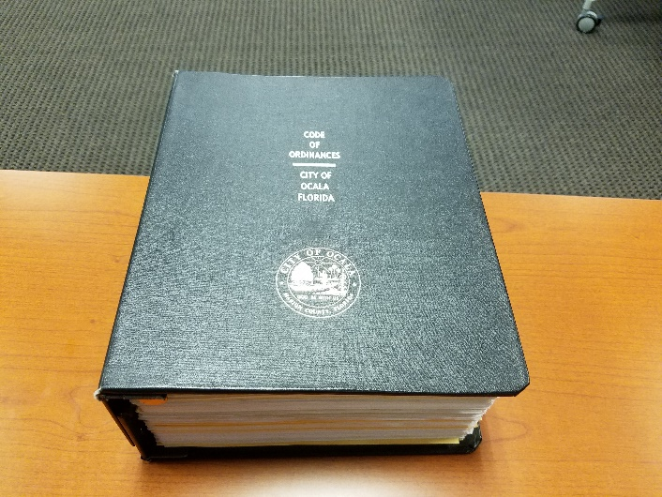
Code amendments!

Slide 8
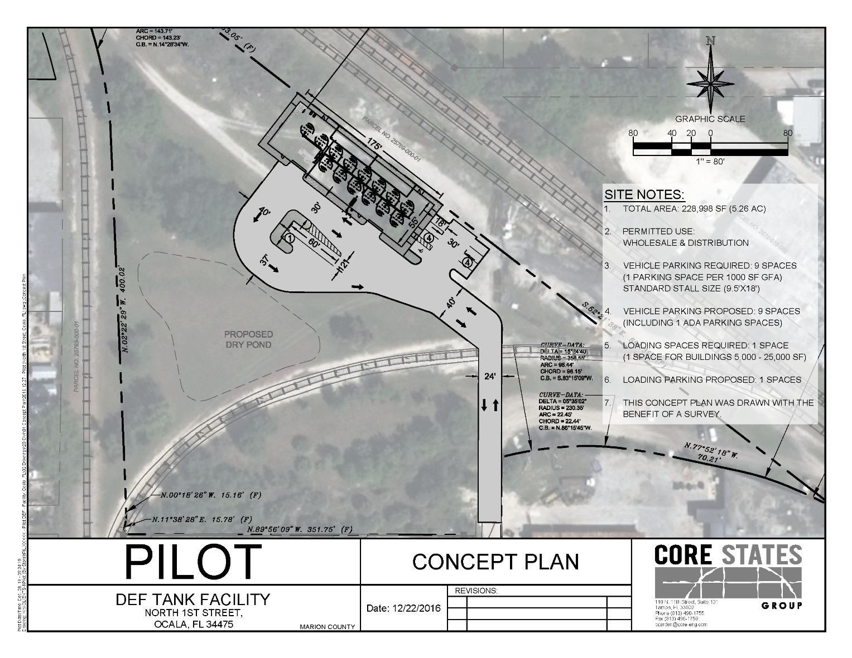
DEF blending plant proposal

Slide 9
Upcoming meetings
Leadership Group
  Thursday, February 23rd at 11:30 am at CSC Training Room
City Council
  Tuesday, February 7th at 4:00 pm at City Council Chambers
  Tuesday, February 21st at 4:00 pm at City Council Chambers
Ocala Historic Preservation Advisory Board
  Thursday, February 2nd at 4:00 pm at City Council Chambers
Planning and Zoning Commission
  Monday, February 13th at 5:30 pm at City Council Chambers
Board of Adjustments
  Monday, February 20th at 5:30 pm at City Council Chambers

Slide 10
Comments / questions

