Slide 1

City of Ocala Leadership Group Meeting
September 22, 2016

Slide 2
Leadership Group Meeting Agenda
Proof of Publication
Midtown Master Plan
Royal Oak
SR 40 & US 27 Corridors
Upcoming projects
  Winding Oaks Farm
  Anderson Columbia Special Exception
  Upcoming meetings
Approval of 8/25 Minutes
Final Comments

Slide 3
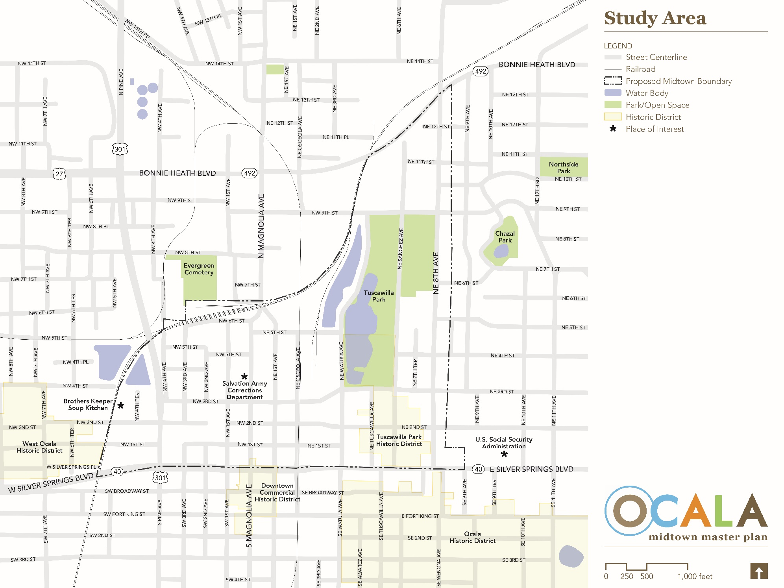
Midtown Master Plan

Slide 4
Royal Oak

Slide 5
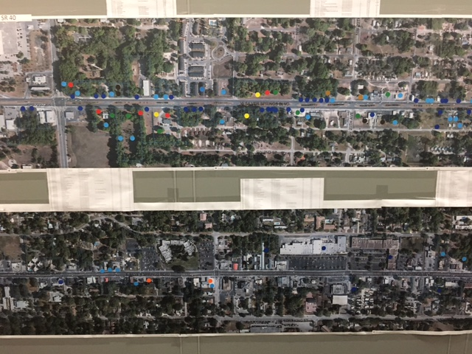

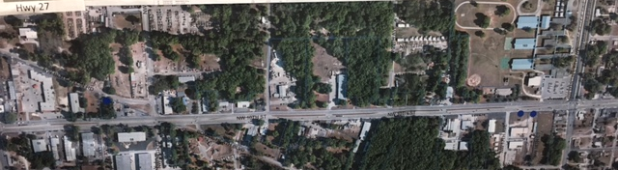
SR 40 and US 27 Corridors

Slide 6
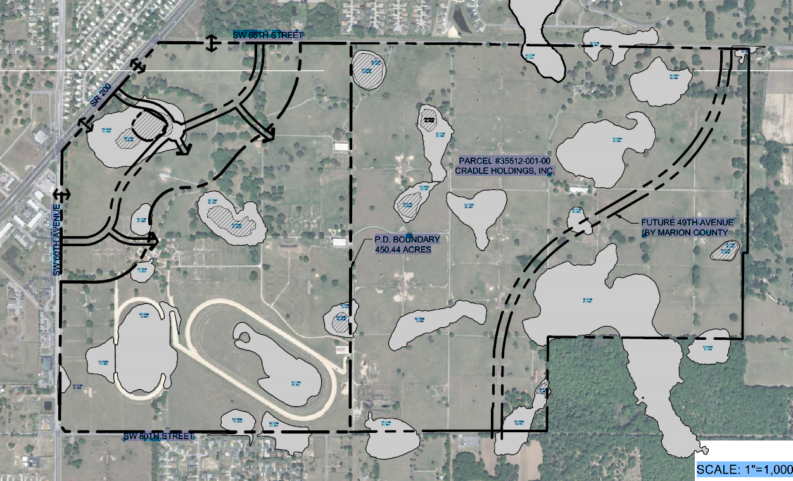
Winding Oaks Farm

Slide 7
Anderson Columbia Special Exception

Slide 8
Upcoming Meetings
City Council Meeting
    Tuesday, October 4th at 4:00 pm at City Council Chambers
    Tuesday, October 18th at 4:00 pm at City Council Chambers
Ocala Historic Preservation Advisory Board
Thursday, October 6th at 4:00 pm at City Council Chambers
Planning and Zoning Commission
Monday, October 10th at 5:30 pm at City Council Chambers
Board of Adjustments
Monday, October 17th at 5:30 pm at City Council Chambers

Slide 9
Approval of 8/25 minutes

Slide 10
Comments / Questions

