Slide 1

City of Ocala Leadership Group Meeting
July 28, 2016

Slide 2
Leadership Group Meeting Agenda
Midtown Master Plan
Vacant or Underutilized Parcels
SR 40 and Magnolia Avenue
Upcoming meetings
Approval of 6/23 Minutes
Final Comments

Slide 3
Midtown Master Plan

Slide 4
Inventory of Vacant/Underutilized Parcels
Notes:
Sent email to Matt L

Slide 5
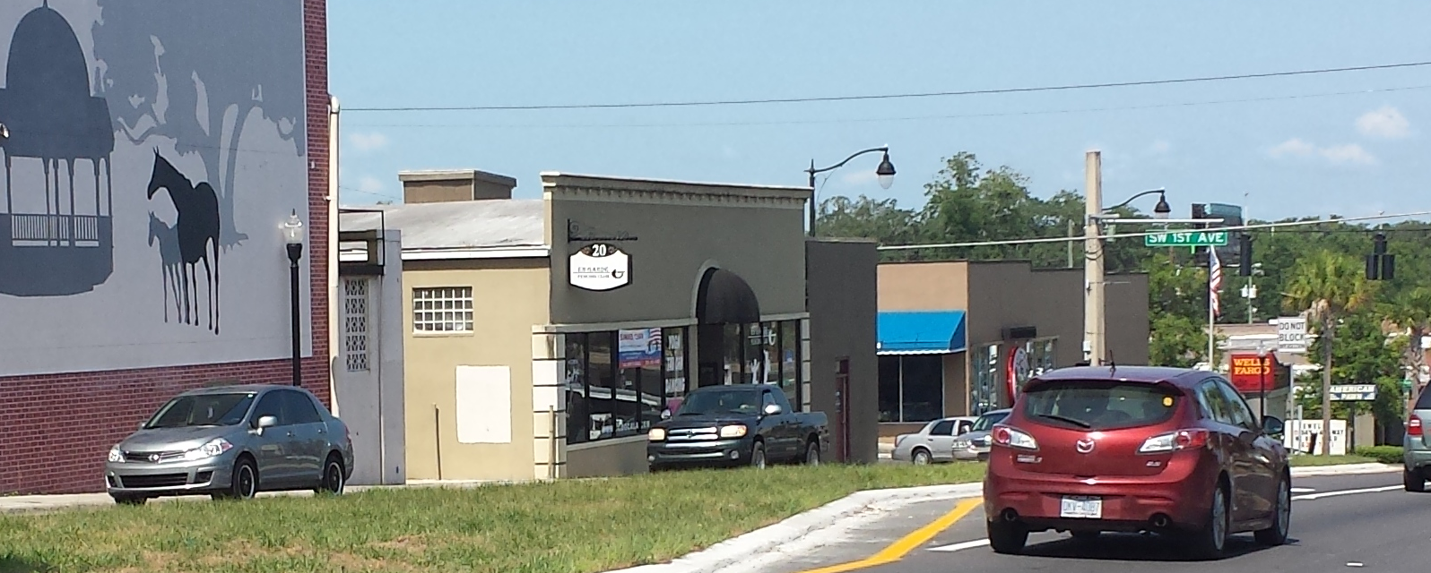
SR 40 and Magnolia Avenue Tree Planting
Meet FDOT and City requirements i.e. spacing
Low Maintenance
Water
Aesthetically Pleasing

Slide 6

Upcoming Meetings
City Council Meeting
    Thursday, August 2nd at 4:00 pm at City Council Chambers
    Tuesday, August 16th at 4:00 pm at City Council Chambers
Ocala Historic Preservation Advisory Board
Thursday, August 4th at 4:00 pm at 2nd Floor CSC Training Room
Planning and Zoning Commission
Monday, August 8th at 5:30 pm at City Council Chambers
Midtown Master Plan Bus Tour & Stakeholder Meetings
Monday - Tuesday, August 8th and 9th

Slide 7
Approval of 6/23 minutes

Slide 8
Comments / Questions

