Slide 1

City of Ocala Leadership Group Meeting
May 26, 2016

Slide 2
Leadership Group Meeting Agenda
Downtown Construction
Midtown Master Plan
Paradise Park Plaza
Proposed Urban Farm
Country Green Planned Development
Village Green
Upcoming meetings
Approval of 4/28 Minutes
Final Comments

Slide 3
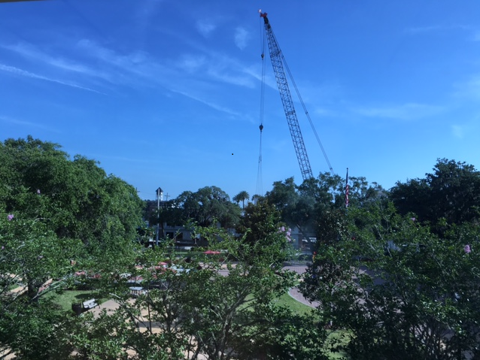
Downtown Construction
Notes:
Left message with Larry MillerParking Garage
Osceola Linear Trail
Historic District Improvements
Water Main Project: Ft King Street from SE 8th Ave to Watula Avenue (estimated completion 6/22)
Farm Market

Slide 4
Midtown Master Plan

Slide 5
Paradise Park Plaza

Slide 6
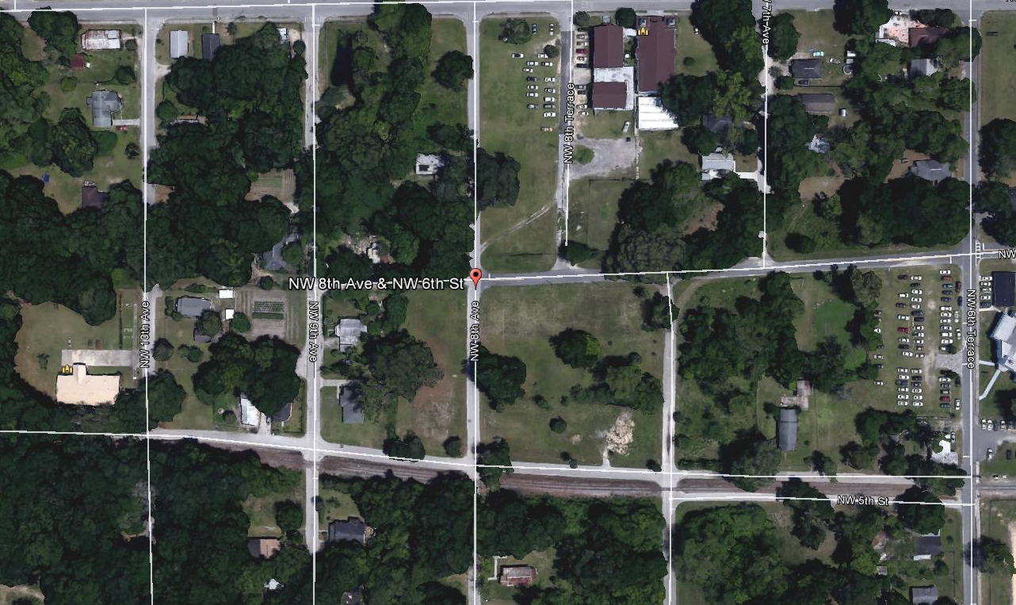
Proposed Urban Farm

Slide 7
Country Green Proposed Planned Development
Notes:
Sent email to Matt L

Slide 8
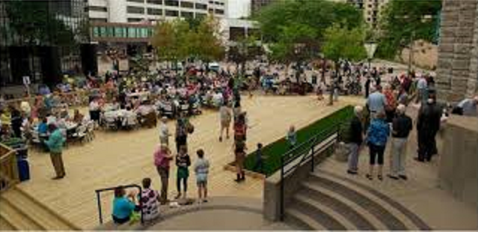
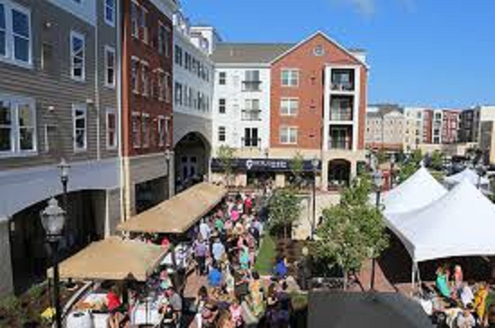
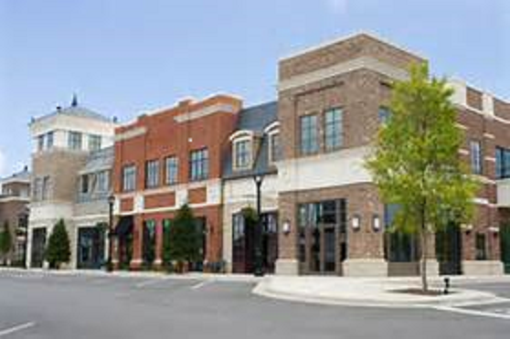
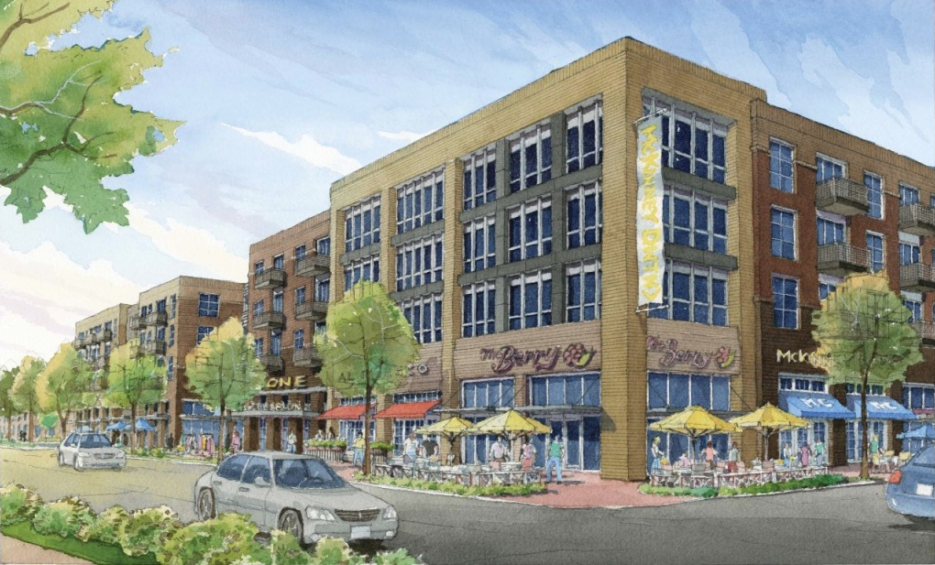
Concepts
Notes:
Sent email to Matt L

Slide 9
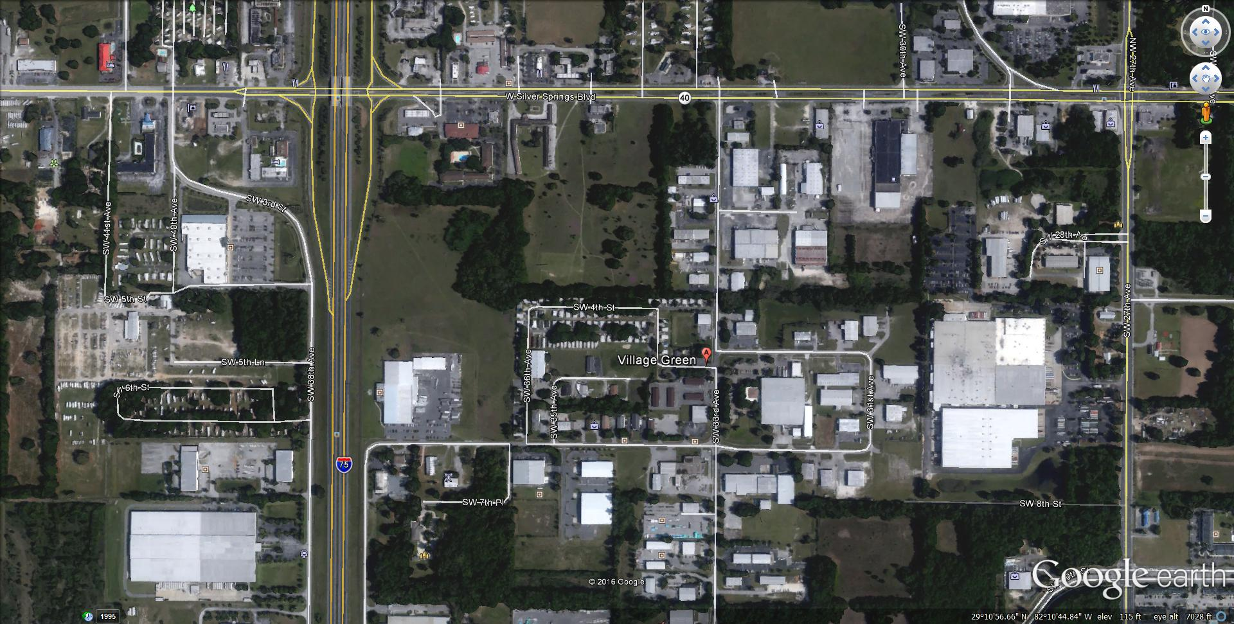
Village Green
Notes:
Sent email to Matt L

Slide 10

Upcoming Meetings
City Council Meeting
    Tuesday, June 7th at 4:00 pm at City Council Chambers
    Tuesday, June 21st at 4:00 pm at City Council Chambers
Ocala Historic Preservation Advisory Board
Thursday, June 2nd at 4:00 pm at 2nd Floor CSC Training Room
Homelessness Seminar (Andrae Bailey)
Friday, June 10th at 10:30 am at the Reilly Arts Center
Planning and Zoning Commission
Monday, June 13th at 5:30 pm at City Council Chambers
I-75 Relief Community Open House
Wednesday, June 8th, at 5:30 pm at the Ocala Hilton

Slide 11
Approval of 4/28 minutes

Slide 12
Comments / Questions

