Slide 1

City of Ocala Leadership Group Meeting
February 25, 2016

Slide 2
Leadership Group Meeting Agenda
Downtown Development Update
  Parking Garage
  Linear Trail
  Private Development
    US 441/Broadway
    Ritter Building (Magnolia/Fort King)
    Alarion Bank site (Osceola Avenue and SR 40)
Estella Byrd Whitman Wellness Center
Midtown Master Plan
Upcoming meetings
Approval of 1/26 Minutes
Final Comments

Slide 3
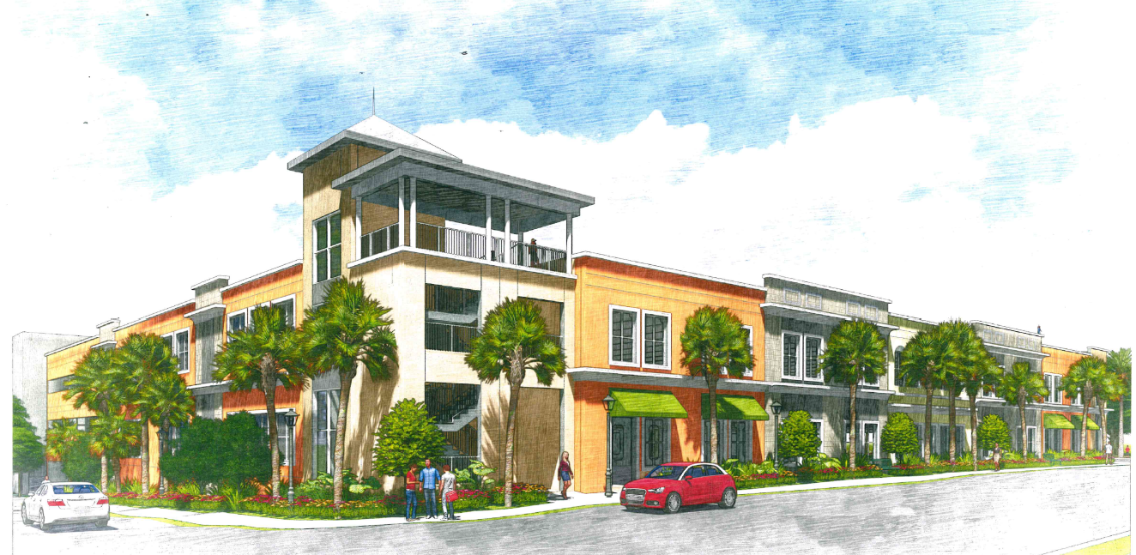
Downtown Parking Garage

Slide 4
Osceola Linear Trail

Slide 5
US 441/Broadway

Slide 6
Ritter Building at Ft King/Mag

Slide 7

Alarion Bank at Osceola / SR 40

Slide 8
Estella Byrd Whitman Wellness Center

Slide 9
Midtown Master Plan

Slide 10
Upcoming Meetings
City Council Meeting
    Tuesday, March 1st at 4:00 pm at City Council Chambers
    Tuesday, March 15th at 4:00 pm at City Council Chambers
Ocala Historic Preservation Advisory Board
Thursday, March 3rd at 4:00 pm at 2nd Floor CSC Training Room
Planning and Zoning Commission
Monday, March 14th at 5:30 pm at City Council Chambers
West Ocala Town hall meeting
Thursday, March 3rd at 6:00 pm at Howard Middle School
Tree Commission Meeting
Monday, March 7th at 1:00 pm at 2nd Floor CSC Training Room
Notes:
Significant Cases: Auto Upholstery Shop, Peter Pensa site

Slide 11
Approval of 1/26 minutes

Slide 12
Comments / Questions

