Slide 1

City of Ocala Leadership Group Meeting
November 18, 2015

Slide 2
Leadership Group Meeting Agenda
West Ocala CRA
Downtown Hotel Project
SR 40 and US 27 Corridors
Upcoming Events Downtown
Upcoming meetings
Approval of 10/22 Minutes
Final Comments

Slide 3
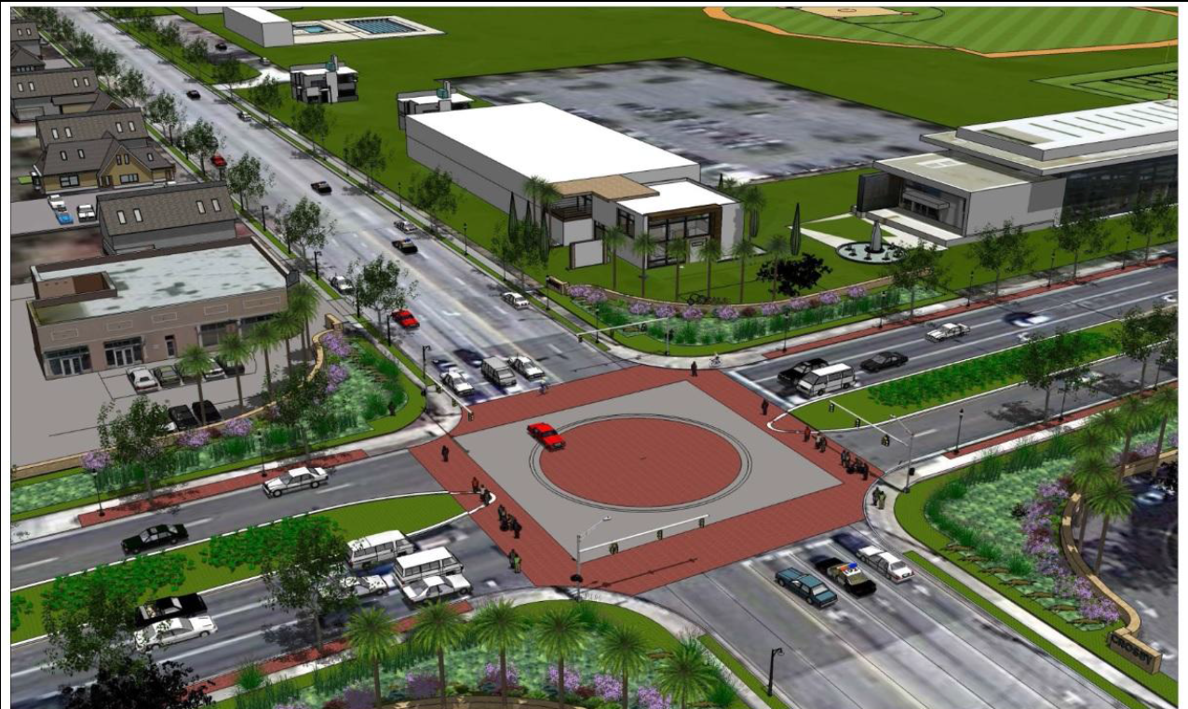
West Ocala CRA

Slide 4
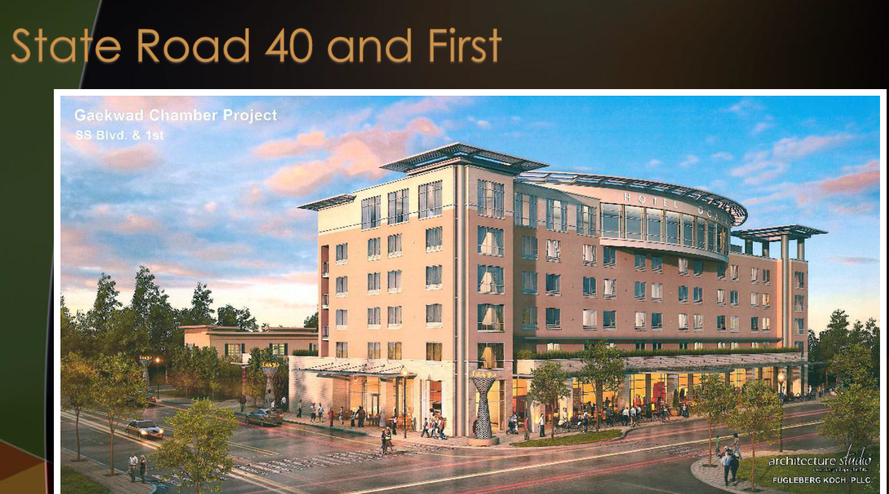
Downtown Hotel Project

Slide 5
Downtown Hotel

Slide 6
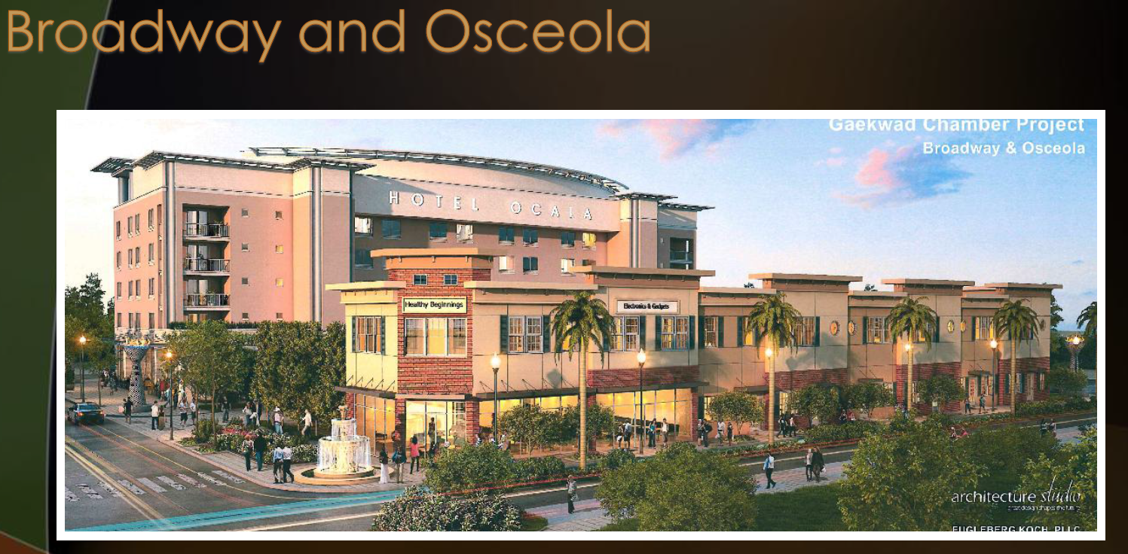
Downtown Hotel Project

Slide 7
Downtown Hotel

Slide 8
Downtown Hotel

Slide 9

SR 40 and US 27 Corridor
North Magnolia Area
Phoenix Heights
East SR 40
West SR 40 Corridor
US 27

Slide 10
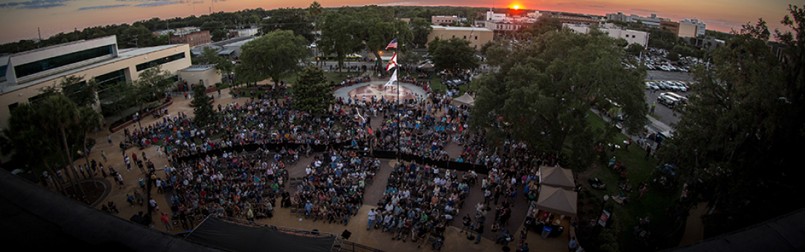
Upcoming Events Downtown

Slide 11
Upcoming Meetings
City Council Meeting
    December 1st at 4:00 pm at City Council Chambers
    December 15th at 4:00 pm at City Council Chambers
Ocala Historic Preservation Advisory Board
December 3rd at 4:00 pm at 2nd Floor CSC Training Room
Notes:
Significant Cases: Auto Upholstery Shop, Peter Pensa site

Slide 12
Approval of 10/22 minutes

Slide 13
Comments / Questions

