Slide 1
City of Ocala Leadership Group Meeting September 24, 2015

Slide 2
Leadership Group Meeting Agenda
Public Market
Property Maintenance Ordinance
SR 40 and US 27 Corridors
Pre-Treatment Facility Special Exception
Upcoming meetings
Approval of 8/24 Minutes
Final Comments

Slide 3
Upcoming Meetings
City Council Meeting
October 6th at 4:00 pm at City Council Chambers
October 20th at 4:00 pm at City Council Chambers
Ocala Historic Preservation Advisory Board
October 1st at 4:00 pm at 2nd Floor CSC Training Room
Market Ventures Site Visit
Meeting with 2035 Leadership Group, 2:15 – 3:00 pm at CEP Board Room
(310 SE 3rd Street)
Planning and Zoning Commission
October 12th at 5:30 pm at City Council Chambers
Board of Adjustment
October 19th at 5:30 pm at City Council Chambers
Notes:
Significant Cases: Auto Upholstery Shop, Peter Pensa site

Slide 4
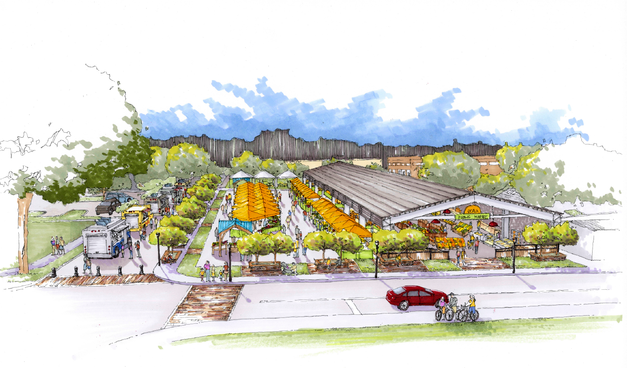
Public Market

Slide 5
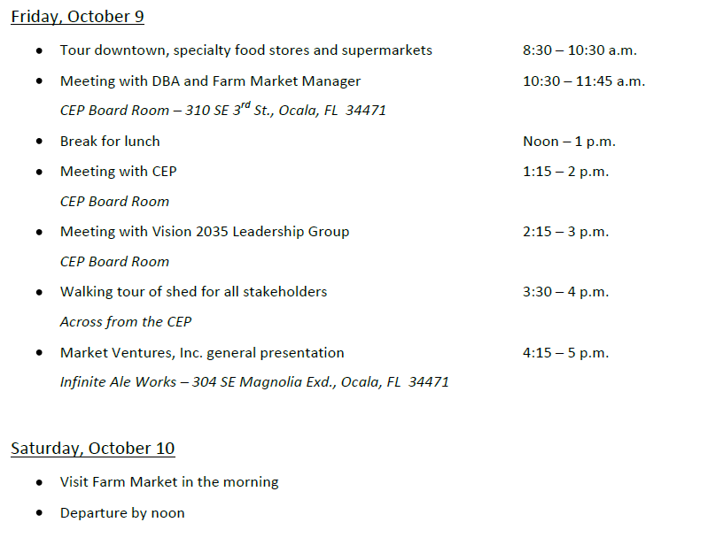
Public Market—Site Ventures itinerary

Slide 6
Property maintenance ordinance

Slide 7
SR 40 and US 27 Corridor

Slide 8
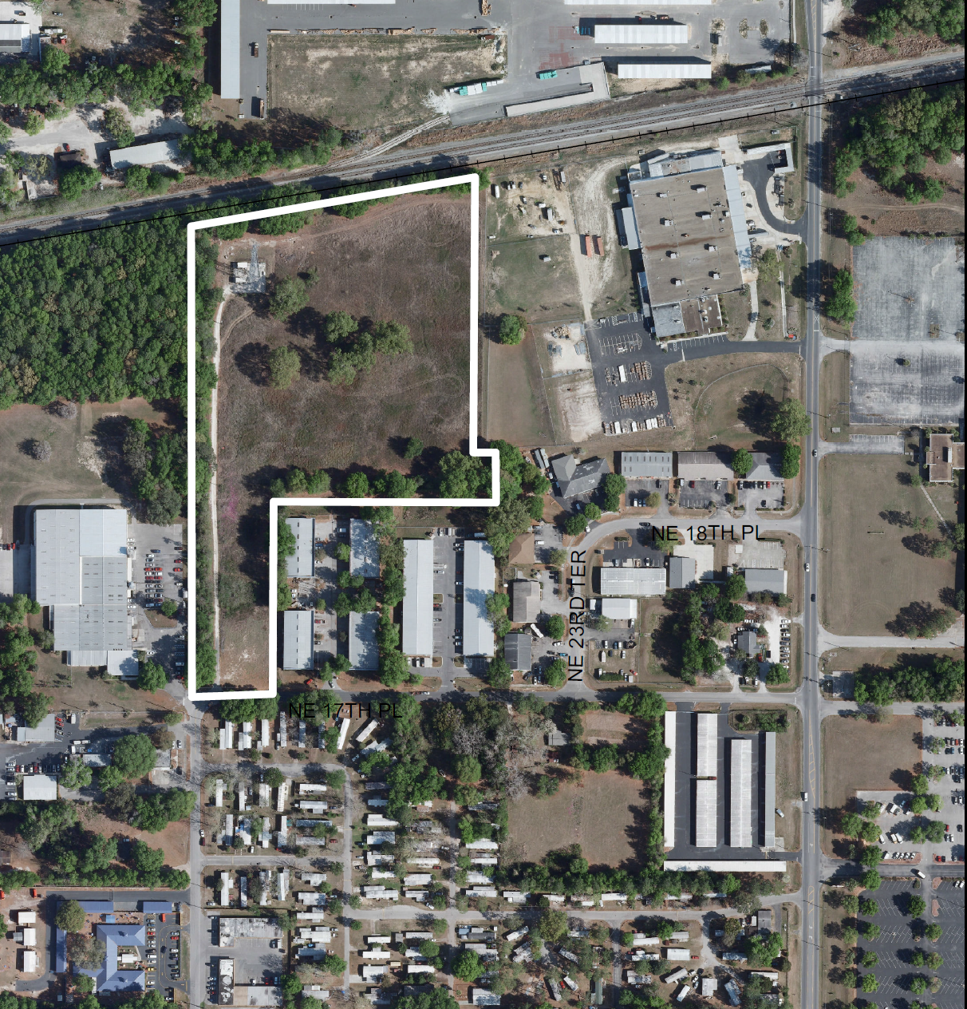
Pre-treatment facility Special Exception

Slide 9
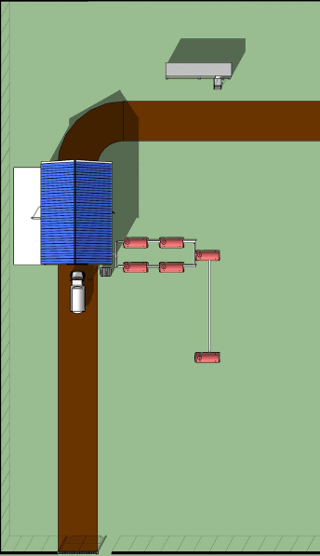
Pre-treatment facility Special Exception

Slide 10
SR 40 and US 27 Corridor

Slide 11
Approval of 8/27 minutes

Slide 12
Comments / Questions

